Slide 1
Revitalization of the Reno-Sparks Livestock Events Center
Next Step in an ongoing project
Presentation to Nevada State Public Works Board
Wednesday, August 26, 2020

Slide 2
Current Request
Revitalization of RSLEC – Next Step
During the 2019 Legislative cycle the request for funding to complete advance planning and schematic design documents was included in Governor Sandoval’s recommended projects but was replaced late by a project for the Sawyer Building.
During the 2019 Legislative session funding for advance planning and schematic design was provided by an appropriation included in SB 501.
This request, the next step, is for design development through construction documents for Phase I of the new construction phase of the project. The estimated cost for this request is approximately $4.4 million; one-third of which would be non-state funding.
2,000 square foot Central Plant designed to serve current and future phases.
63,000 square foot Exhibit Hall. This will replace the recently demolished Exhibit Hall.
74,800 square foot Indoor Arena. This will complement the existing indoor arena and make the facility attractive to more diverse and larger events.
Exterior refurbishing of existing Indoor Arena including access and ADA improvements.

Slide 3
History of Property
Revitalization of RSLEC – Next Step
Approximately 80 acres acquired, and trust created, by the State of Nevada, in the 1880’s. Over the years various acreage has been used for surrounding streets leaving approximately 40 acres usable to the facility.
The trust identified the property’s use as promotion and encouragement “…of the interest of agriculture, horticulture, mechanics, manufactures (sic), stock raising, and general domestic industry.”
The management of the land was specifically left to the “Nevada State Agricultural Society” established in 1873. In 1885 the Society was made a “State Institution” and the “State Board of Agriculture” was created.
In 1951 the Legislature passed a bill requiring the lease of the property to Washoe County. In 1971, the Legislature extended the lease to 99 years, expiring in 2050. The Washoe County Office complex and Senior Center is currently located on the southern portion of the original 80 acres.
In 1986, Washoe County and the Reno Sparks Convention and Visitors Authority (RSCVA)entered into a management agreement whereby the Authority took over management of the RSLEC.
Since 1986 the facility experienced many years of success but needs revitalization.
In 2018 the State Public Works Division estimated there was over $16 million of deferred maintenance at the RSLEC.

Slide 4
Current Situation
Revitalization of RSLEC – Next Step
Recognizing the need for improvement and a phased approach, the Exhibit Hall (built in 1968) and old National Guard Armory were recently demolished by the RSCVA.
The demolition of the Exhibit Hall eliminates about $750,000 of deferred maintenance listed in the 2018 State Public Works Board Facility Condition Analysis Report.
To date, the revitalization project has been funded both publicly and privately, including the $1 million investment from the State of Nevada during the 2019 legislative session (SB 501) for advance planning and schematic design of the master plan.
The State’s investment was matched dollar for dollar by the Reno Rodeo Association. To date, the Reno Rodeo Association has funded $1.25 million in support of the planning and due diligence for the revitalization project.
We are 99% complete with the advance planning and 30% schematic design phase funded by SB 501. The associated traffic study was delayed by the Covid-19 pandemic but is currently underway. The work was conducted by Frame Architecture; a firm that has worked successfully with the Public Works Division in the past.
The final task is a business plan/feasibility study that is currently being conducted by Applied Analysis.
We have reverted $100,000 of the $1 million appropriated by SB 501.

Slide 5
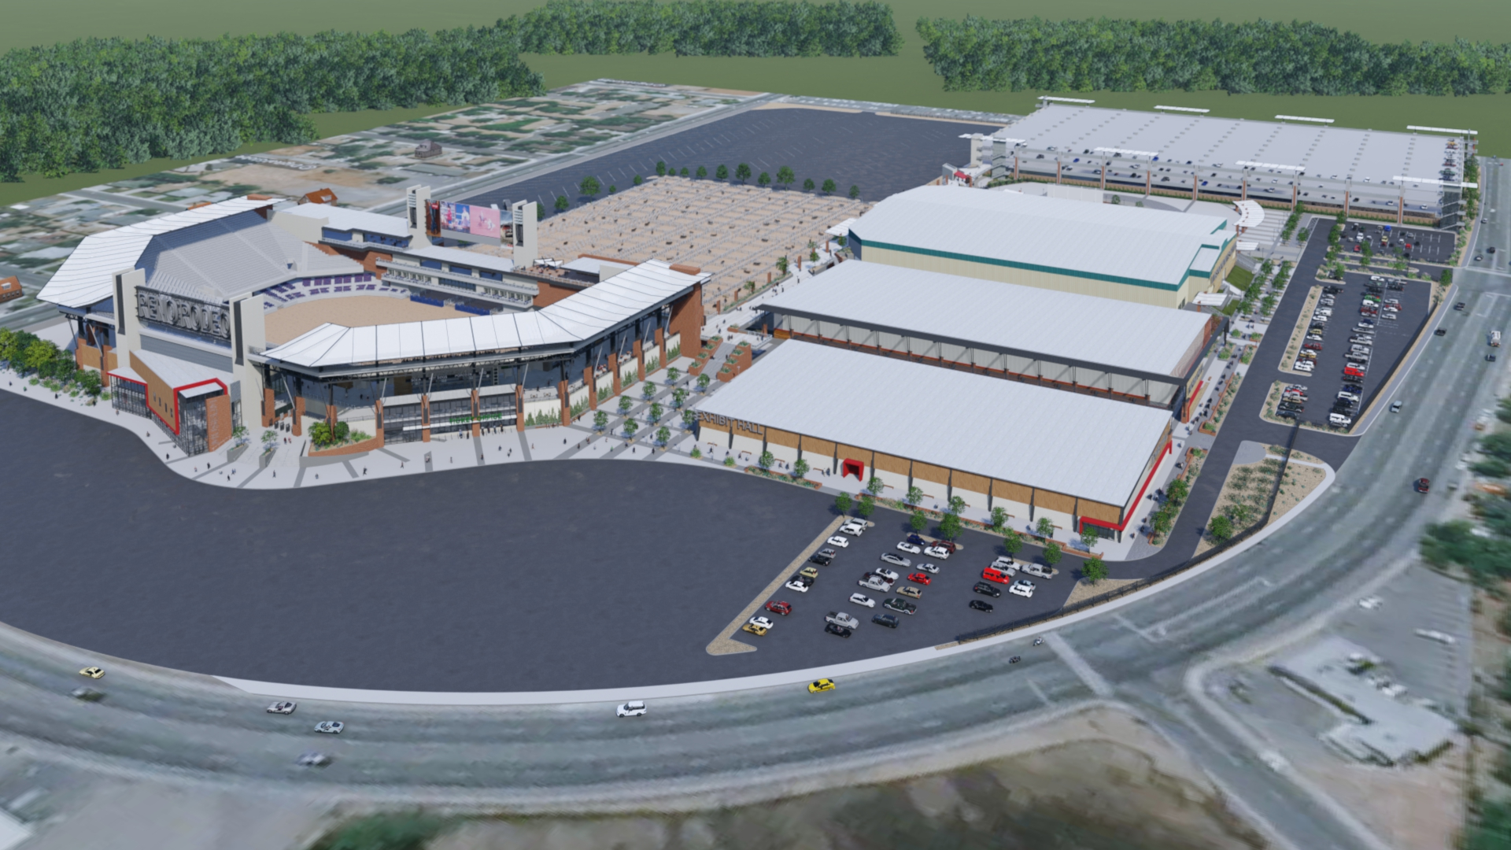
Proposed Solution
Revitalization of RSLEC – Next Step

Slide 6
Proposed Solution (continued)
Revitalization of RSLEC – Next Step
This site plan is showing the new event center components. Phase I is highlighted.
The new plan is superimposed over the existing facility, including the Washoe County Complex and Senior Center.
The proposal is for shared funding between State, local, Federal, and private funding sources.
The Nevada Western Heritage Center Alliance Inc., an independent 501(c)(3) entity, has been created to manage the capital campaign. The chair of that entity’s board of directors is Perry DiLoreto.

Slide 7
Proposed Solution (continued)
Revitalization of RSLEC – Next Step
Phase I stands to benefit the public entities most vested – the Reno Sparks Convention and Visitors Authority, Washoe County, and the Cities of Reno and Sparks - by giving them an attractive facility to sell and promote the area. The concept of “heads in beds” and economic impact.
The Reno Rodeo generates an estimated economic impact of between $40 million and $50 million annually. That is just one of many potential events that can be held regularly.
The revitalization of this property will benefit the larger Northern Nevada community and, more specifically, the immediate surrounding neighborhoods.
The project converts this state-owned property into a state-of-the-art, multi-use, year-round, events center that is primarily designed around agricultural and equestrian events and is easily used for outdoor concerts, small conventions, banquets, and educational events.
Phases have been defined to allow for the ordered completion of the project and to minimize impact on current facility users.

Slide 8
Consequences if not approved
Revitalization of RSLEC – Next Step
If this next step is not approved, we will continue to underutilize a valuable asset.
This property has historically contributed to the health of the region's economy and it will only contribute more as the project moves forward.
Phase I can move from 30% schematic design to “shovel ready” in short order. As we move past the COVID-19 “pause” in economic activity this will be a job creator and provide an economic boost to the State of Nevada.
We mention “shovel ready” should additional Federal stimulus funding become available that targets public works projects such as this.

